Slide 1
Loan default Classification using Logistic regression

Slide 2

Introduction
Dataset Source: https://www.kaggle.com/wordsforthewise/lending-club
Lending Club is the largest online loan marketplace, facilitating variety of loans.
Dataset contain complete loan data for all loans issued through the 2007-2018.
Task: Classify whether loan will be fully paid or charged off i.e. Binary Classification.

Slide 3
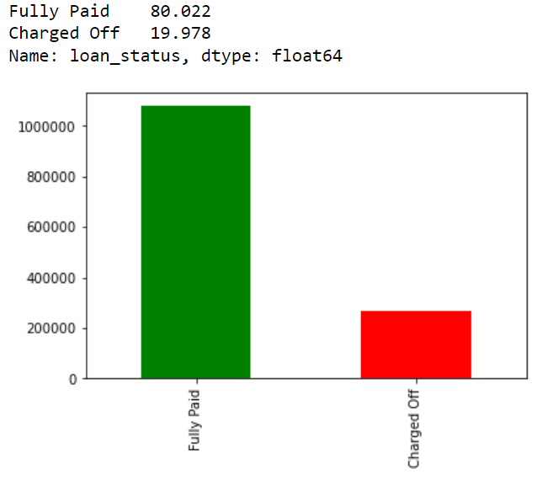
Challenges acts as a Motivation
Almost all columns having Missing values (i.e. NaN)
Heavily imbalanced data: Fully Paid-80%, Charged off-20%
Lots of categorical features.

Slide 4
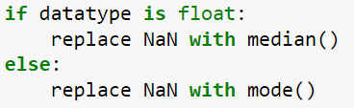
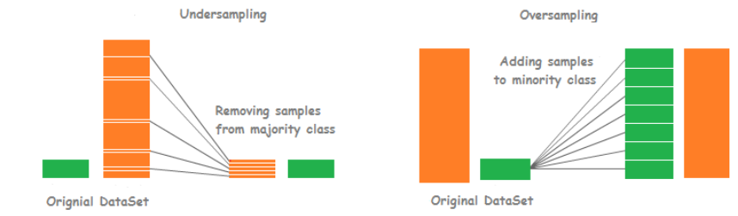
Preprocessing
Delete feature column having Missing values more than 30%
Drop feature column having correlation value greater than 0.98
Delete other unnecessary columns like 'id', 'emp_title', 'issue_d', 'pymnt_plan', 'url', 'title', 'zip_code', 'addr_state’,.. etc.
Consider only Fully paid/Charged off data
Handling Missing data:
Convert categorical features to numerical values
Up/Down Sampling applied to balance the data

Slide 5
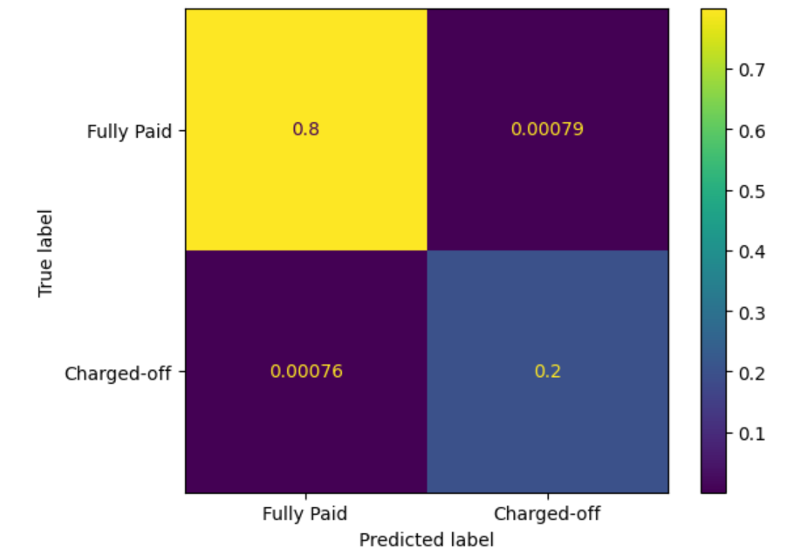
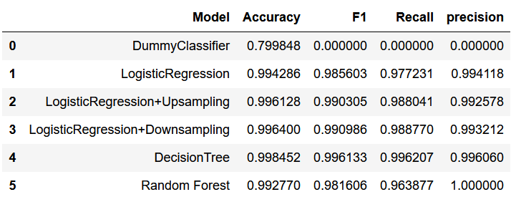
Results
Decision Tree is the best model

